Slide 1

Car Sales Performance Analysis
Uncovering trends in revenue, profitability, brand performance, and market positioning across the U.S. used-car auction market.
By: Vhonani Mphoshomale - Junior Analyst

Slide 2

Table of Contents
01
06
Executive Summary
Geographic Markets
02
07
Brand Volume Analysis
Profitability Challenge
03
08
Revenue Efficiency
Pricing vs Market Value
04
09
Sales Trend Analysis
Key Insights
05
10
Body Type Distribution
Strategic Recommendations

Slide 3

Executive Summary
137,809
$1.73B
$12,535
TOTAL UNITS SOLD
TOTAL REVENUE
AVERAGE SELLING PRICE
65 / 783
36
18 Mos
CAR MAKES / MODELS
STATES COVERED
JAN 2014 – JUL 2015
KEY INSIGHT
The dataset captures a large-scale U.S. used-car auction market with strong volume but thin — and often negative — profit margins, signaling a highly competitive pricing environment.

Slide 4

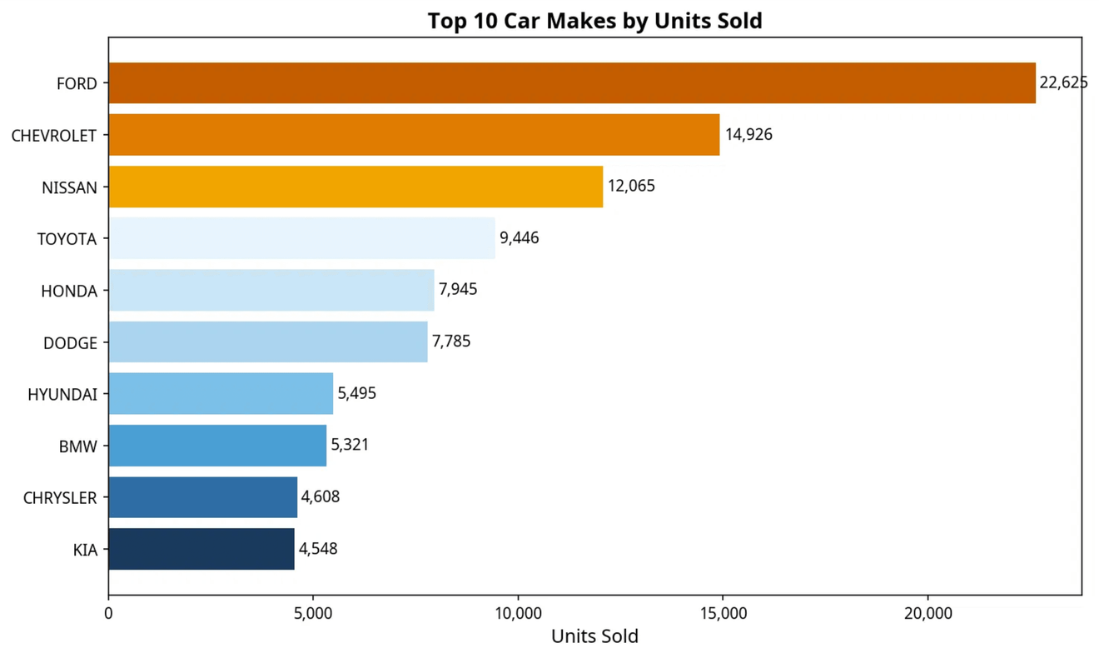
Top Makes by Units Sold
Ford Dominates Volume
Ford leads with 22,625 units sold — nearly 50% more than second-place Chevrolet (14,926).
Asian Brands Follow
Nissan ranks 3rd with 12,065 units, followed by Toyota (9,446) and Honda (7,945).
Domestic Strength
Domestic brands (Ford, Chevrolet, Dodge, Chrysler) collectively account for ~36% of total volume.
Premium Positioning
BMW ranks 8th in units but 4th in revenue, reflecting its premium pricing advantage.

Slide 5

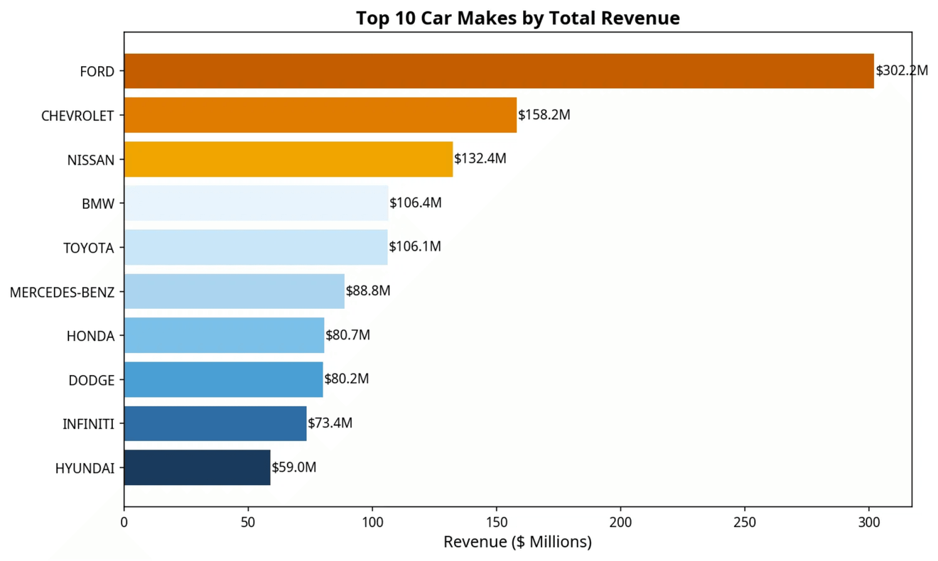
Top Makes by Revenue
$302.2M
Ford generates $302.2M in total revenue, nearly double Chevrolet's $158.2M.
Luxury Leverage
BMW ($106.4M) and Mercedes-Benz ($88.8M) rank 4th and 6th despite lower unit volumes, demonstrating the revenue leverage of luxury pricing.
High Transaction Value
Infiniti ($73.4M) appears in the top 10 by revenue despite not featuring in the top 10 by units.
Balanced Mid-Market
Toyota and Honda show balanced volume-to-revenue ratios, reflecting their mid-market positioning.

Slide 6

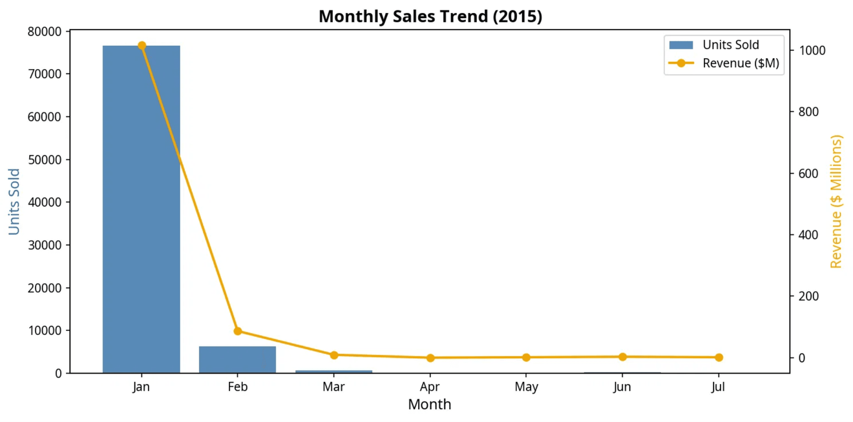
Sales Trend Analysis
2015 Sales Surge
2015 saw a 56% increase in units and 84% in revenue compared to 2014, driven by early-year activity.
2014 Revenue:
$607.6M (53k units)
2015 Revenue:
$1.12B (84k units)
January 2015 Anomaly
January alone accounted for 76,606 units and $1.02B in revenue — an extraordinary concentration suggesting a major auction event or data batch.
Post-January Drop
The sharp drop after January suggests seasonal or operational factors that significantly reduced transaction volume in subsequent months.

Slide 7

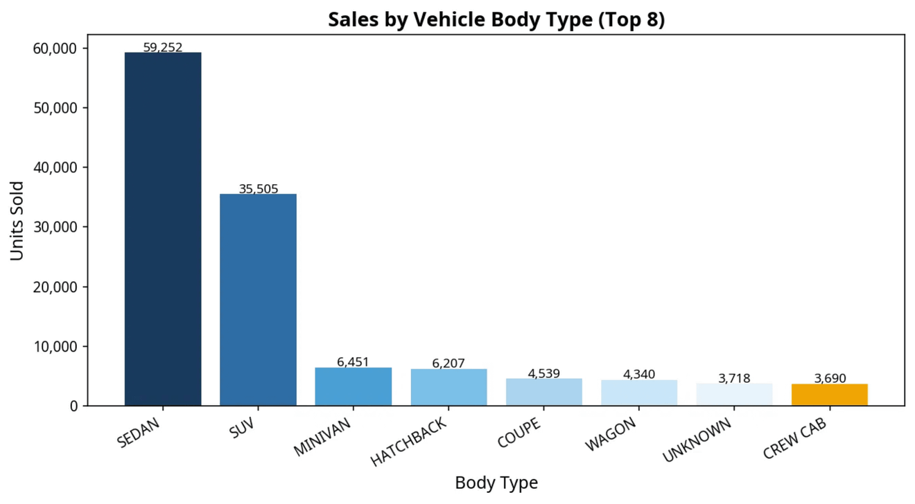
Sales by Body Type
Sedans Dominate
Sedans lead with 59,252 units (43% of total), reflecting strong consumer demand for everyday passenger vehicles.
SUVs Rank Second
SUVs follow with 35,505 units (26%), consistent with the broader industry shift toward crossovers and utility vehicles.
Family & Urban Segments
Minivans (6,451) and Hatchbacks (6,207) occupy the 3rd and 4th positions, serving specific demographic needs.
Niche Markets
Convertibles (2,695) and Crew Cabs (3,690) represent specialized segments with potentially higher per-unit values.

Slide 8

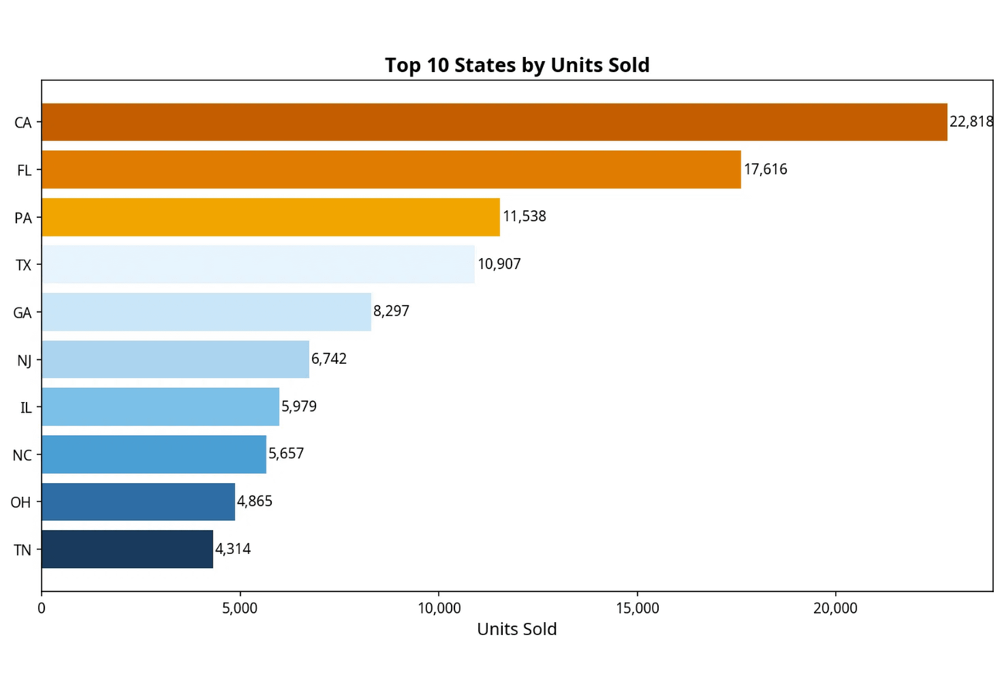
Top States by Sales
29.4%
California (22,818) and Florida (17,616) combined drive nearly 30% of all national sales volume.
72.4%
The top 10 states collectively account for ~103,000 units, indicating high geographic concentration.
Coastal
Southern and coastal states dominate, reflecting population density and active used-car auction markets.

Slide 9

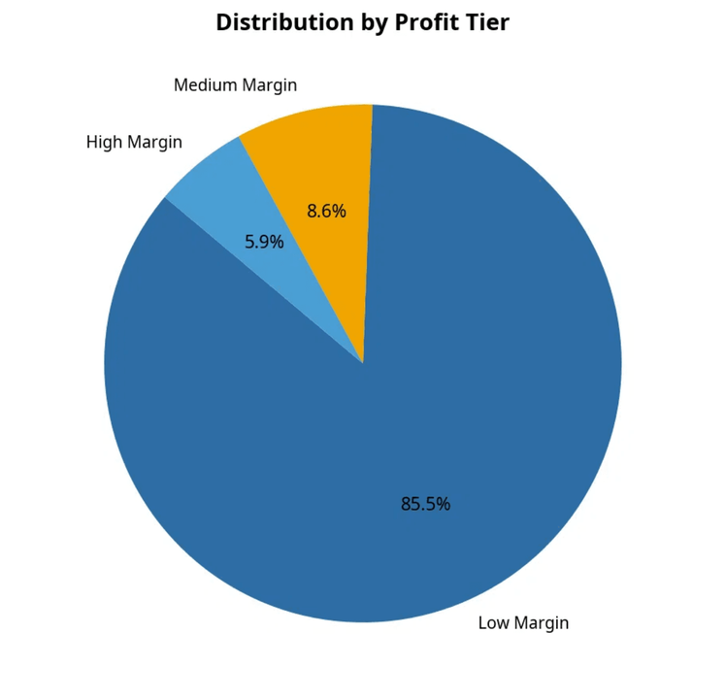
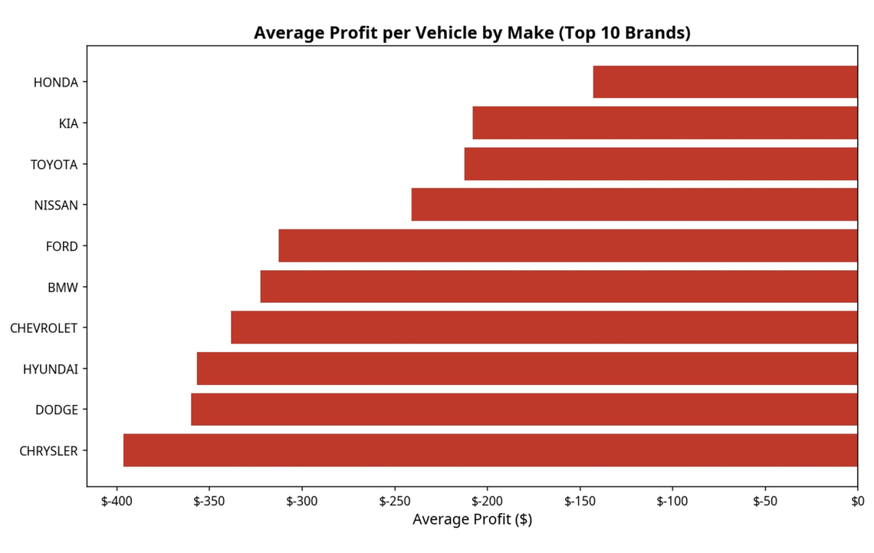
Profitability Challenge
85.5%
-$292
ZERO
of all transactions fall into the "Low Margin" tier, with only 5.9% classified as "High Margin."
overall average profit per vehicle, meaning the market is operating at a net loss on average.
top-10 brands achieve a positive average profit. Honda posts the best (–$143), while Chrysler performs worst (–$396).

Slide 10

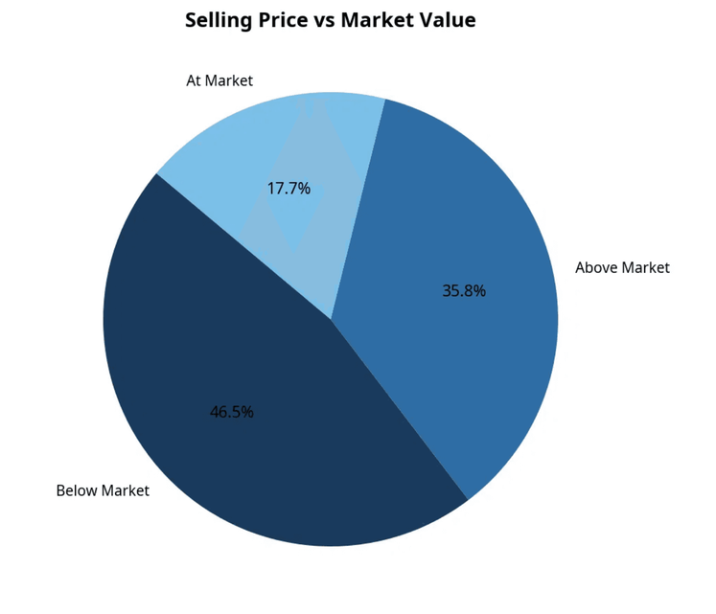
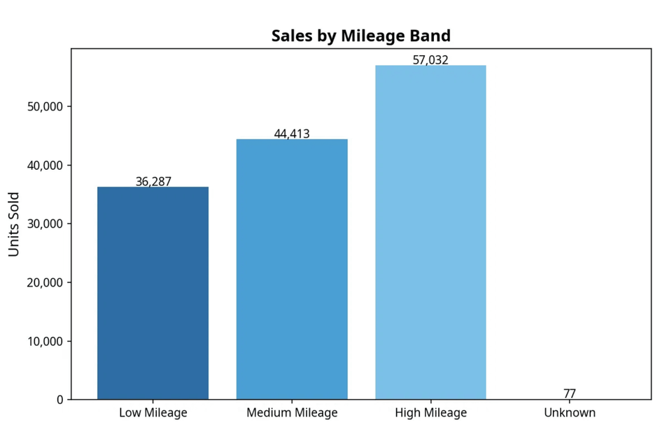
Pricing vs. Market Value
46.5%
41.4%
TARGET
of vehicles (64,056 units) were sold below market value, indicating a systematic underpricing trend across the board.
of sales are high-mileage vehicles, whose dominance in the inventory mix contributes heavily to the below-market pricing pattern.
Realigning pricing strategy for low-mileage, high-condition vehicles toward market rates could meaningfully improve overall profitability.

Slide 11


Key Insights
MARKET DYNAMICS
OPERATIONAL REALITIES
High Volume, Low Margin: The U.S. used-car auction market operates at a net loss on average (–$292/vehicle), signaling extreme pricing competition.
Pricing Inefficiencies: 46.5% of vehicles are sold below market value, largely driven by the high proportion of high-mileage inventory.
Geographic Concentration: Nearly 30% of national volume is concentrated in just two states (CA and FL), suggesting a need for geographic diversification.
Brand Performance: Ford and Chevrolet dominate volume, but premium brands like BMW and Mercedes-Benz show significantly higher revenue efficiency.

Slide 12

Strategic Recommendations
01
02
OPTIMIZE PRICING STRATEGY
FOCUS ON HIGH-MARGIN SEGMENTS
Shift below-market vehicles toward at-market or above-market pricing, particularly for low-mileage and high-condition inventory. A 5% price improvement on the 64,056 below-market units could recover ~$40M in lost margin.
Prioritize acquisition and resale of luxury and premium vehicles (BMW, Mercedes-Benz, Infiniti) which show higher revenue per unit. Expand inventory in SUV and low-mileage categories where demand is strong.
03
04
GEOGRAPHIC EXPANSION
INVENTORY MIX REBALANCING
Deepen market presence in high-volume states (CA, FL, TX) while exploring underserved mid-tier markets (e.g., OH, TN) where competition may be lower and margins potentially higher.
Reduce reliance on high-mileage, low-condition vehicles that drive below-market pricing. Increase the share of low-mileage inventory to improve average transaction value and margin profile.

Slide 13

THANK YOU
For questions or further analysis, please contact:
Vhonani Mphoshomale
Junior Analyst
https://vhonanimphoshomale.lovable.app/

